Slide 1
ALEx MIS
Dashboard design team update
© Allianz 2022
Allianz SE
Global Commercial – Data Team
Munich, Germany January 2023

Slide 2

Byron
Contents
How did we leave things when last we met?
What has happened since
Overview - Byron
Analysis – Suhas & Pirmin
MVP – Max & Jenny?
KPIs – Jan-Hendrik
GDA foundation dashboards – Max & Jenny?
AT solution design – Christoph?
Data office/GBG/CIM CRs for missing/erroneous attributes – Myriam?
Q1 Timeline – Mattias?
What happens next? - Byron

Slide 3

Byron
1. How did we leave things?
When last we met, the Dashboard Design Group had:
Collated all known requirements, which had been lodged as User Stories in Jira
Reviewed potential candidates for a ‘Foundation’ analytics dashboard design
Selected existing AGCS dashboards as the target for our foundation release

Slide 4

Byron
2a. What has happened since then - overview
Since last we met, the Data team has:
Analysed the AGCS dashboards to determine what attributes are available within the existing data-set
Co-ordinated the development of an ‘MVP’ dashboard for demo and OE onboarding/UAT purposes
Worked with GDA team to refine requirements for foundation release
Liaised with Development teams to develop overall solution design for Q1 foundation release
Collaborated with Data Standards to define change requests for missing attributes needed for future releases

Slide 5
Analysis of AGCS dashboards against available data
Pirmin & Suhas

Slide 6
Collation of AGCS dashboard requirements
Compilation of dashboard requirements from the current capabilities of AGCS dashboard
To develop the foundation version of the dashboard, existing AGCS dashboard was chosen as it had broad range of KPIs that could cover the rest of the OEs’ requirements
The requirements were analyzed to derive the required data and its granularity to assess the feasibility of the development of the dashboard
The analysis was used to develop the plan to develop the dashboard
Below is the high-level result of the analysis of existing AGCS dashboard-
The unavailable KPIs/fields corresponds to either new business or AGCS specific or a single KPI visualized on different aggregation level
Detailed table is available in appendix
 | Data fields availability
Dashboard | Available | Not required | Unavailable
Claims | 42 |  | 2
Premium | 44 | 1 | 21
Pricing | 28 | 14 | 10
Rate and Retention | 41 | 15 | 4

Slide 7
Analysis of full dashboard requirements
Collated the requirements for the dashboard from the user stories on Jira by AZ D, AZ UK and AGCS and created a backlog
Removed the overlapping requests from different OEs
Analyzed the tickets to obtain the necessary data and its granularity from CIM
Added the obtained list of distinct KPIs across AZ D, AZ UK and AGCS to the existing list of requirements
GDA was commissioned to compile a set of KPIs from the list that can be implemented with existing capacity in Q1 2023.

Slide 8
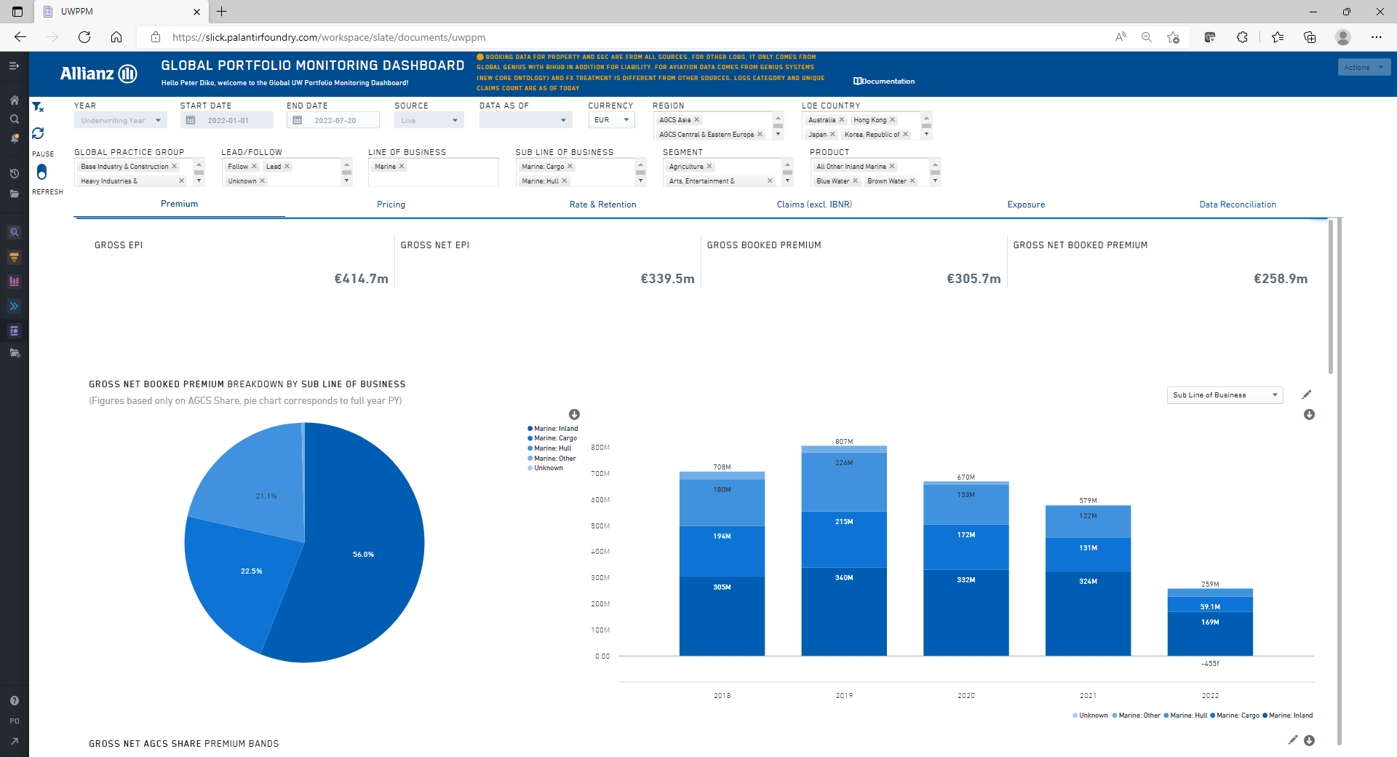
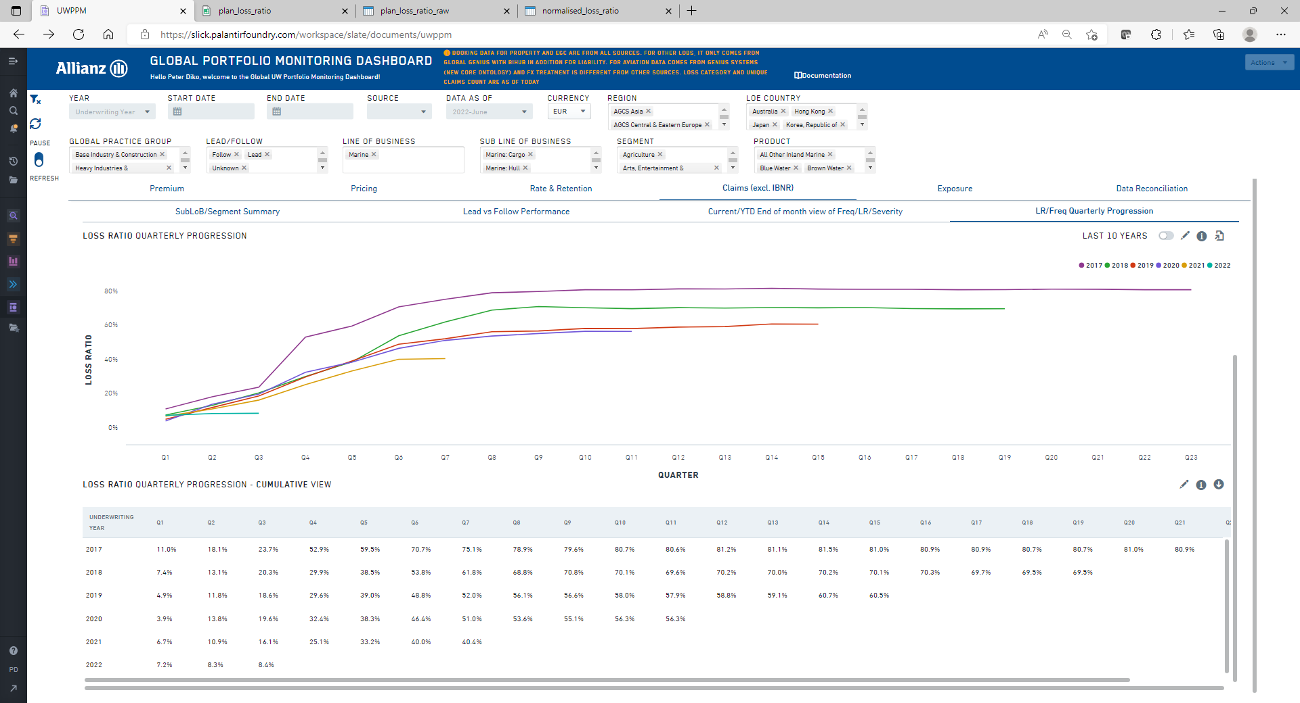
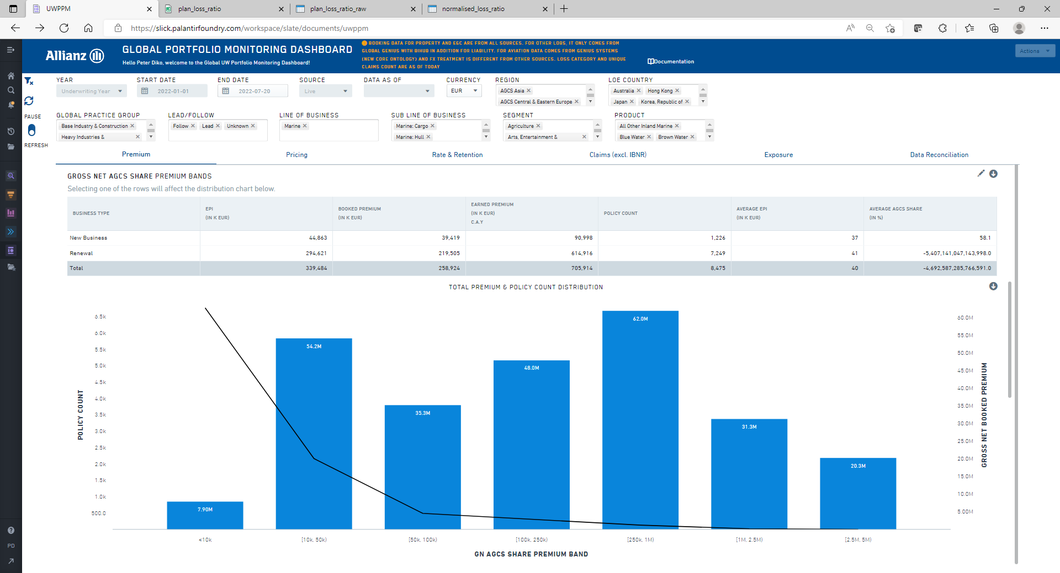
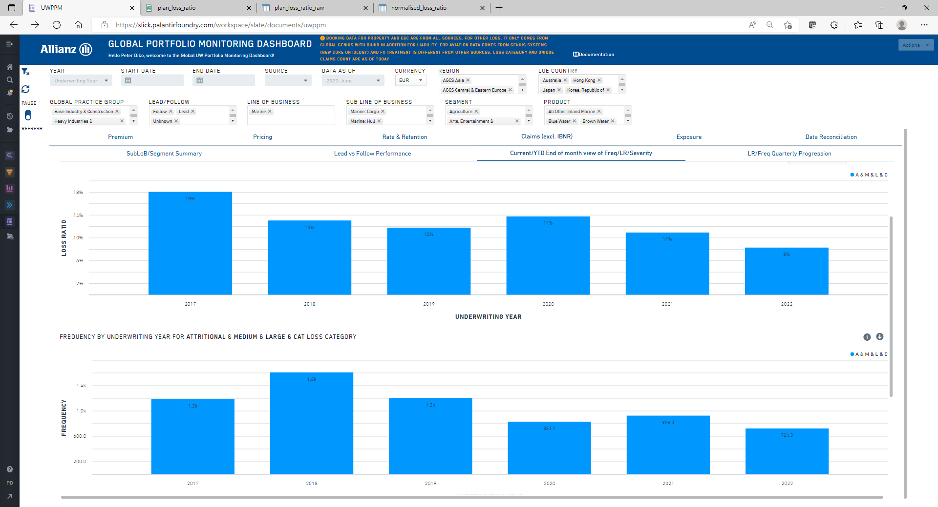
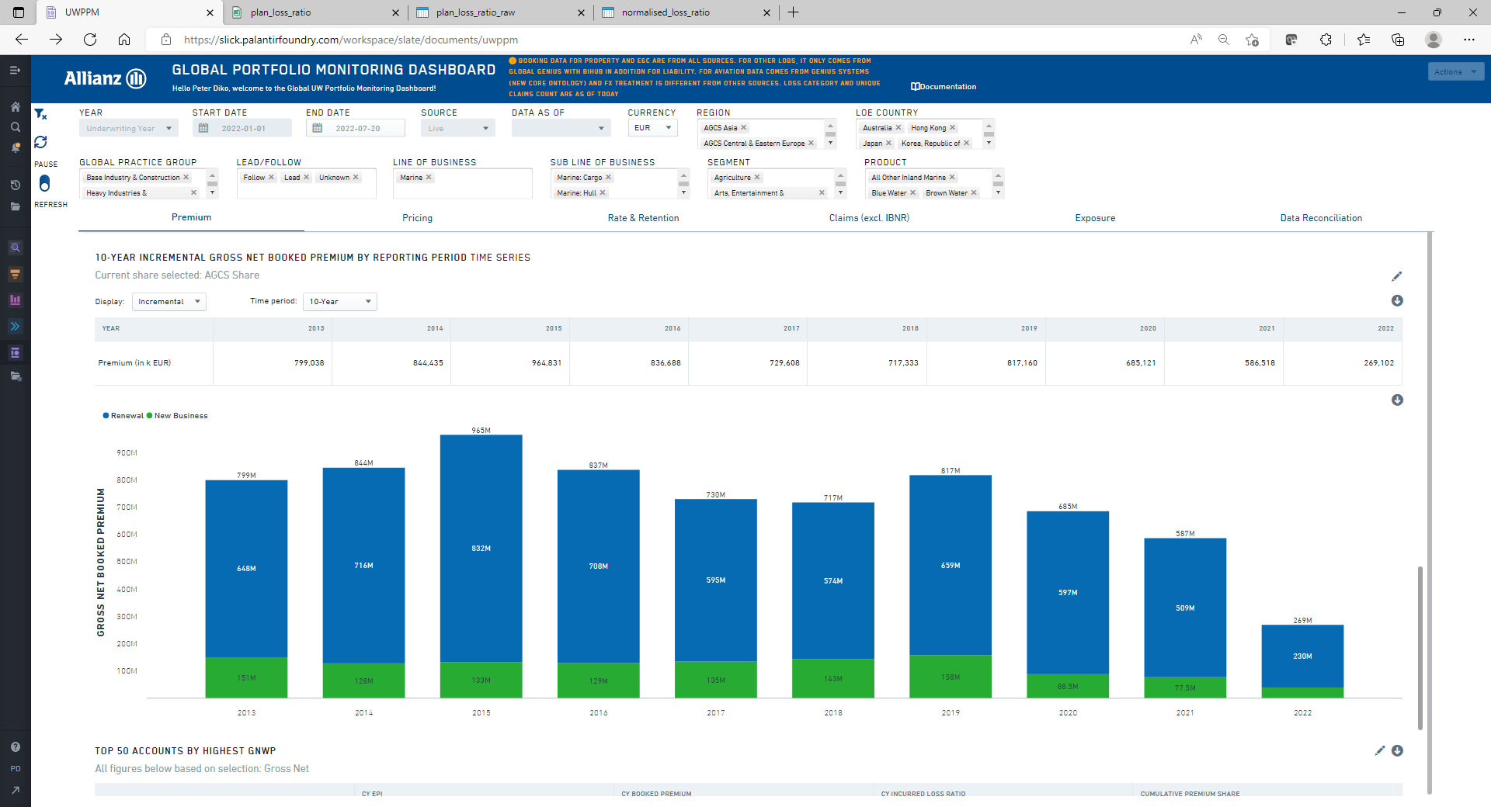
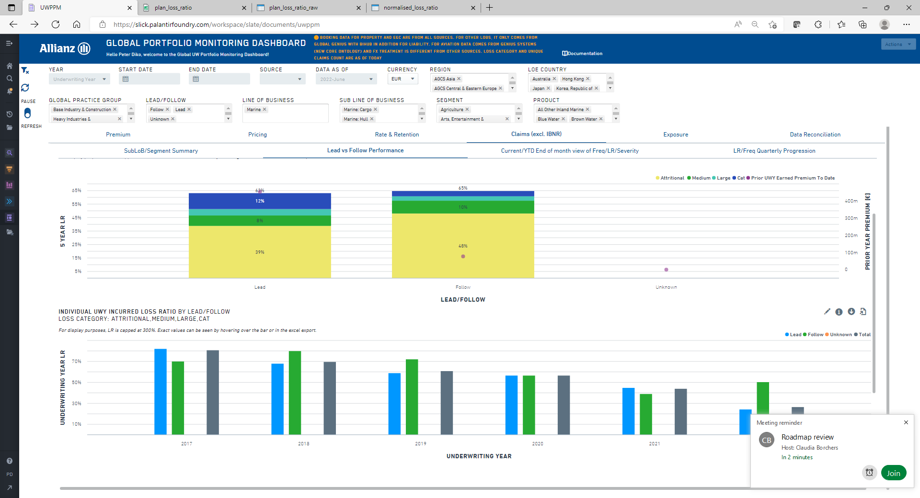
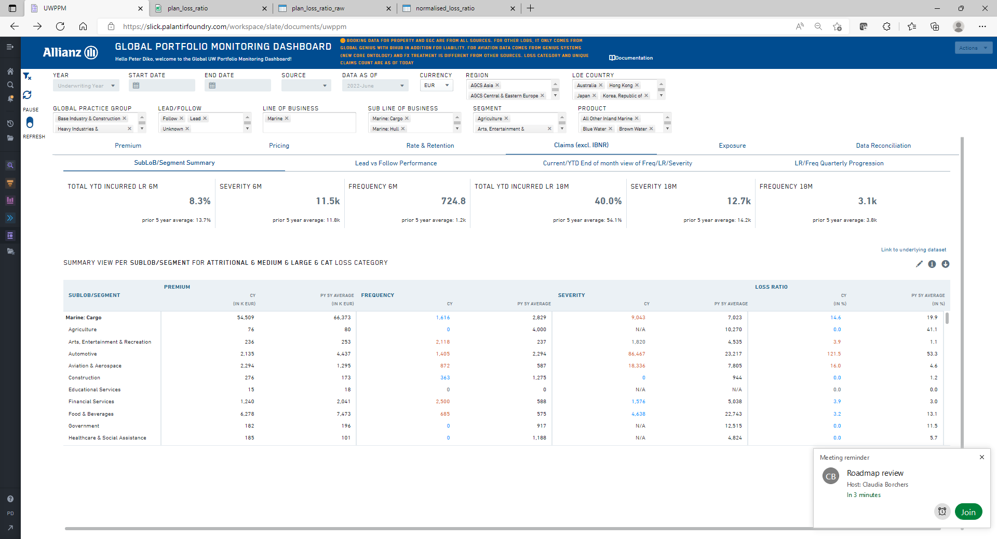
Current capabilities – AGCS

Slide 9
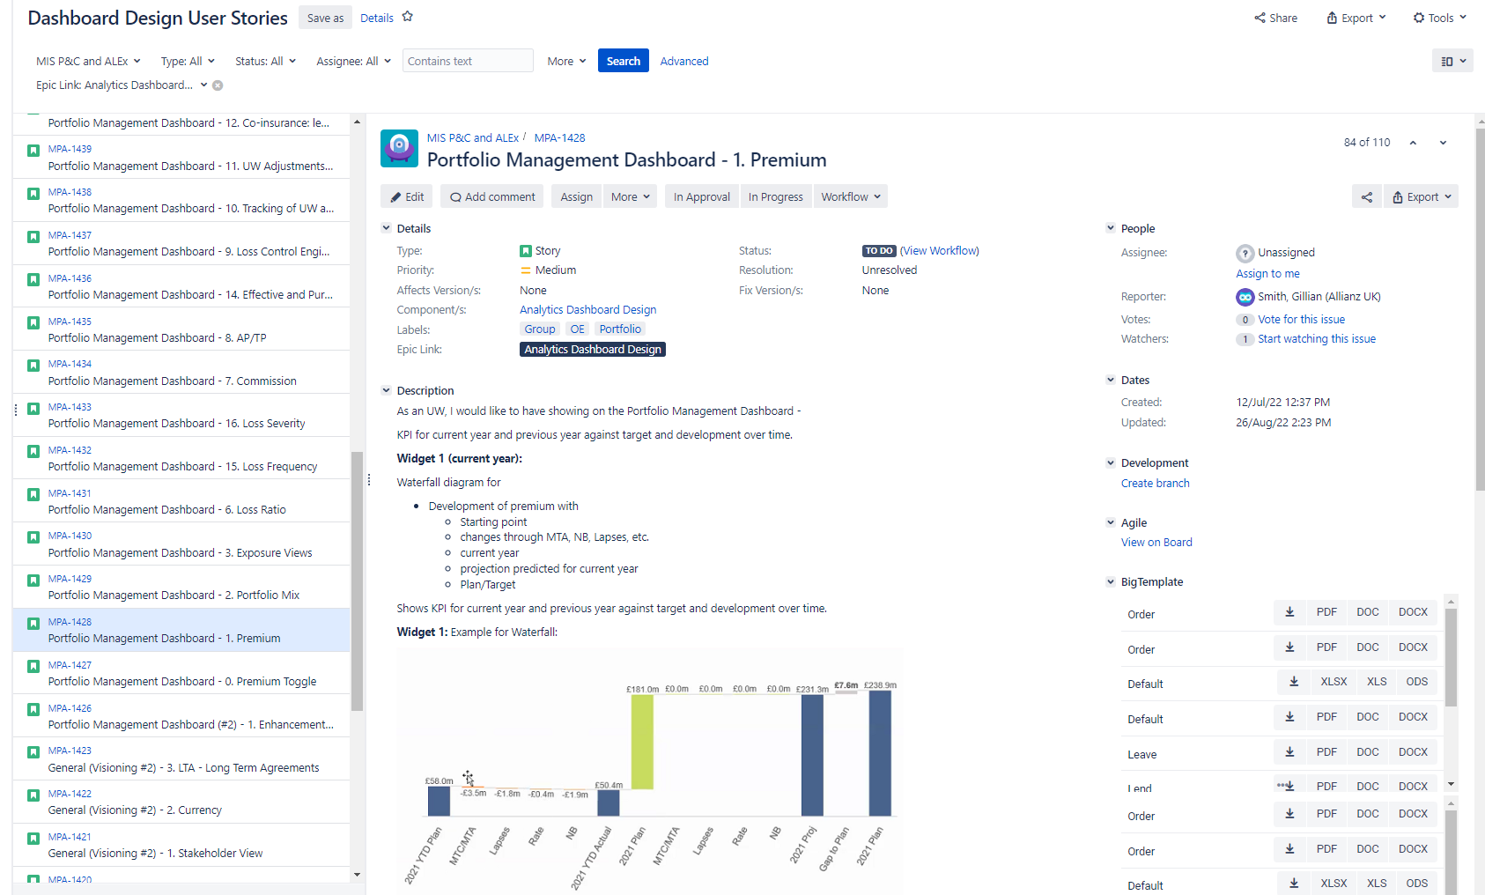
Additional requirements from JIRA
Example user story for dashboard requirement: link

Slide 10
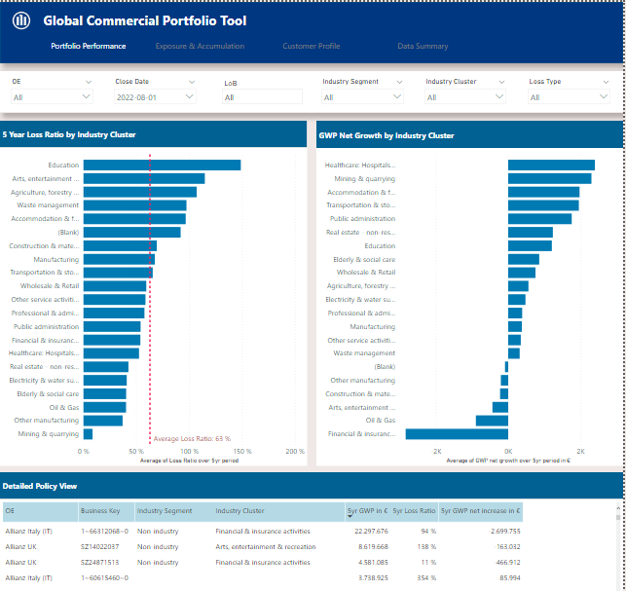
ALEx MVP Dashboard capabilities
Max & Jenny
Portfolio Performance
loss ratio
average portfolio loss ratio benchmark
GWP
net increase in GWP

Slide 11
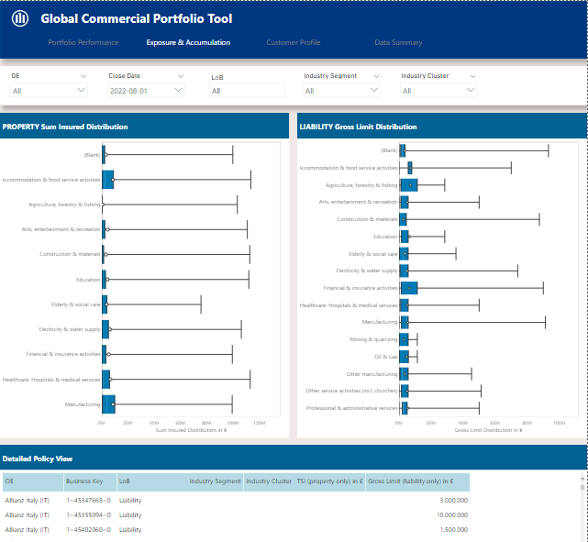
ALEx MVP Dashboard capabilities
Max & Jenny
Exposure & Accumulation
Minimum, Maximum and Average Sum Insured for Property policies
Minimum, Maximum and Average Gross Limit for Liability policies

Slide 12
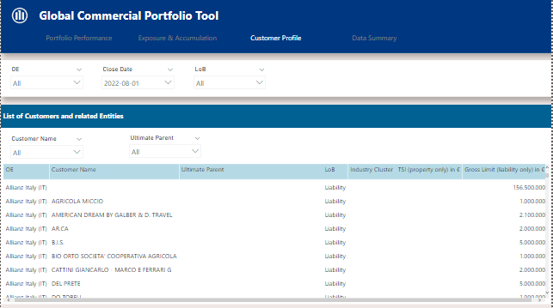
ALEx MVP Dashboard capabilities
Max & Jenny
Unique Customer View
Company holding structure hierarchy

Slide 13
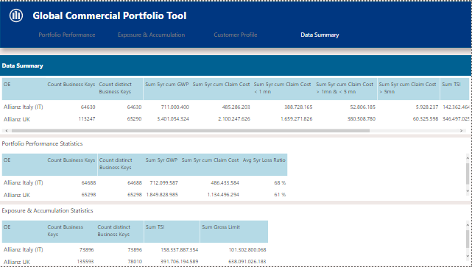
ALEx MVP Dashboard capabilities
Max & Jenny
Data Summary

Slide 14
Set Up Consumption Layer
Christoph

Slide 15
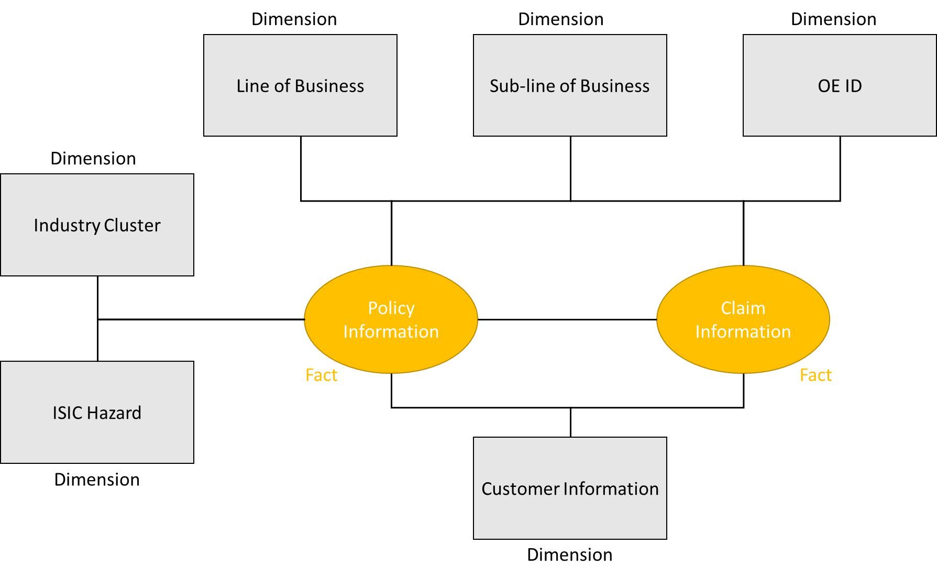
Model Consumption Layer

Slide 16
Analysis of foundation dashboard requirements
With the compiled set from GDA a model for the consumption layer was created which ensures the following front-end capabilities:
Cross-Filtering between dimensions
Annual aggregated views
Trend analysis of KPIs
Distribution of measures
Segmentation

Slide 17
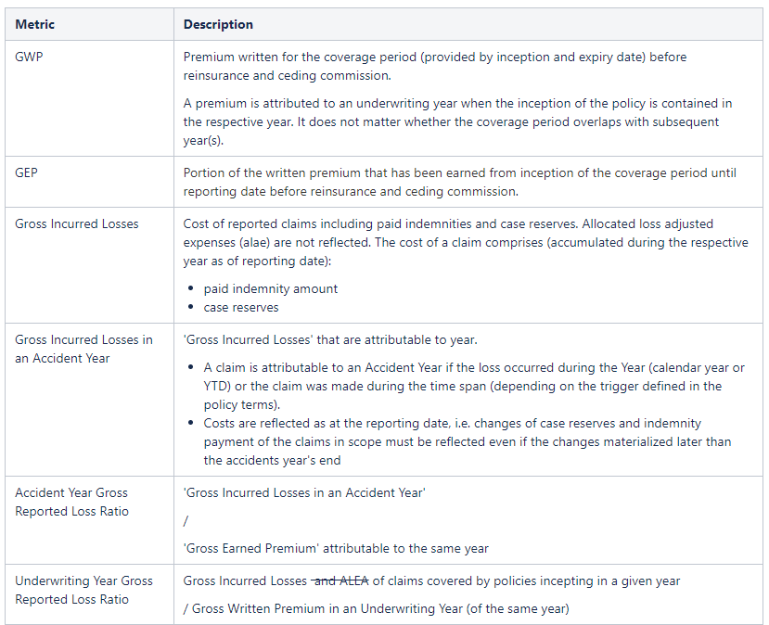
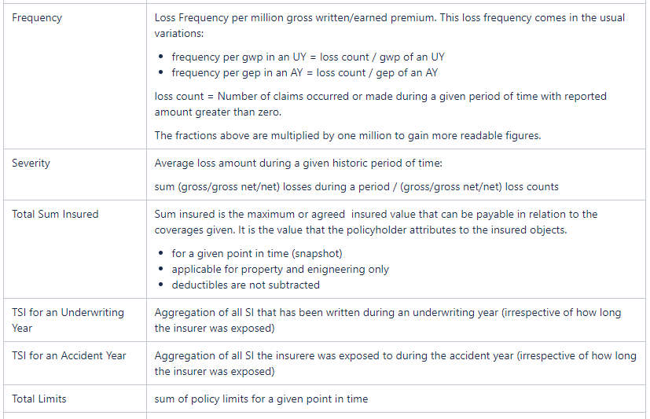
Technical Specification of Metrics and KPI
Detailed explanation of derived metrics for ALEx MIS - link

Slide 18
End of Quarter 1 2023

Slide 19
ALEx Foundation Dashboard Scope
Max & Jenny
General modifications:
Granularity: Drill down from five year to one year aggregation (Underwriting & Accident Year)
Specific views: Addition of new filter options
Volume: New KPIs with focus on claims and premium
Dashboard Features:
Cross-OE Benchmarking: contrast of OEs on different KPIs and dimensions
Segment Analysis: in-depth view with drill down capabilities of OEs on different KPIs and dimensions

Slide 20
Available Business KPIs
Premium
In | Out
GWP/ GEP split in UW year & Accident year (option to have multiple years cumulative) | GNWP/ GNEP split in UW year & Accident year (option to have multiple years cumulative)
Net increase in GWP split in UW year & Accident year (option to have multiple years cumulative)
Claims
In | Out
Severity split in UW year & Accident year
Frequency split in UW year & Accident year
Loss ratio split in industry cluster | Gross Net Loss ratio split in industry cluster
Loss ratio split in UW year & Accident year (option to have multiple years cumulative) | Gross Net Loss ratio split in UW year & Accident year (option to have multiple years cumulative)
Portfolio Performance
In | Out
Loss ratio split in UW year & Accident year (option to have multiple years cumulative) | Net loss ratio split in UW year & Accident year (option to have multiple years cumulative)
Average portfolio loss ratio benchmark split in UW year & Accident | Average portfolio net loss ratio benchmark split in UW year & Accident

Slide 21
Available Business KPIs
Exposure & Accumulation
In | Out
Minimum, Maximum and Average Sum Insured for Property policies
Minimum, Maximum and Average Gross Limit for Liability policies
Customer Profile
In | Out
Company holding structure hierarchy
Data Summary
In | Out
Distinct count of business keys per OE
Summary of all KPIs on Underwriting and Accident Year level per OE
*
*
Calculations related to Premium are only available on Gross basis, because the field premium_share_ceded is not yet available but is considered to be implemented in the CIM in Q1 2023.
Calculations related to incurred/ reported losses are only available on Gross basis, because the current data delivery contains neither reinsurance recoveries nor payments/reserves net of fac but is considered to be implemented in the CIM in Q1 2023.

Slide 22
ALEx Foundational Dashboard Scope
ALEx Dashboard Design: Foundational Dashboard

Slide 23
Appendix

Slide 24
AGCS current KPIs data availability
Dashboard | KPI/Filter | Available? | Not required? | Unavailable?
Claims | Currency Filter | Yes
 | Data As Of Filter | Yes
 | End Date Filter | Yes
 | Frequency (for each of last 5 years) | Yes
 | Frequency 18M | Yes
 | Frequency 18M Prior 5 Year Average | Yes
 | Frequency 6M | Yes
 | Frequency 6M Prior 5 Year Average | Yes
 | Frequency CY | Yes
 | Frequency PY 5Y Average | Yes
 | Global Practice Group Filter | Yes
 | Lead/ Follow |  |  | Yes
 | Lead/ Follow Filter |  |  | Yes
 | Line of Business Filter | Yes
 | LOE Country Filter | Yes
 | Loss Category | Yes
 | Loss Ratio | Yes
 | Loss Ratio (for each of last 5 years) | Yes
 | Loss Ratio CY (In %) | Yes
 | Loss Ratio PY 5Y Average | Yes
 | Premium CY | Yes
 | Premium PY | Yes
 | Premium PY 5Y Average | Yes
 | Product Filter | Yes
 | Region Filter | Yes
 | Segment | Yes
 | Segment Filter | Yes
 | Severity 18M | Yes
 | Severity 18M Prior 5 Year Average | Yes
 | Severity 6M | Yes
 | Severity 6M Prior 5 Year Average | Yes
 | Severity CY | Yes
 | Severity PY 5Y Average | Yes
 | Start Date Filter | Yes
 | Sub Line of Business Filter | Yes
 | Sub LoB | Yes
 | Total YTD Incurred LR 18M | Yes
 | Total YTD Incurred LR 18M Prior 5 Year Average | Yes
 | Total YTD Incurred LR 6M | Yes
 | Total YTD Incurred LR 6M Prior 5 Year Average | Yes
 | Underwriting Year (last 5 years) | Yes
 | Underwriting Year LR (for each of last 5 years) | Yes
 | Underwriting Year/ Quarter (YTD and last 5 years) | Yes
 | Year Filter | Yes
Dashboard | KPI/Filter | Available? | Not required? | Unavailable?
Premium | Account ID | Yes
 | Account Name | Yes
 | AGCS Share |  |  | Yes
 | APTP | Yes
 | Average AGCS Share |  |  | Yes
 | Average EPI |  |  | Yes
 | Booked Premium | Yes
 | Bound |  |  | Yes
 | Business Type | Yes
 | Claims | Yes
 | Currency Filter | Yes
 | Customer Name | Yes
 | Data As Of Filter | Yes
 | Earned Premium | Yes
 | Effective Rate Change | Yes
 | End Date Filter | Yes
 | EPI |  |  | Yes
 | EPI Loss Ratio |  |  | Yes
 | EPI of latest policy |  |  | Yes
 | Expiring Policies (policies up for renewal) |  | Yes
 | Expiring Premium (premium up for renewal) | Yes
 | Expiry Date | Yes
 | Global Practice Group | Yes
 | Global Practice Group Filter | Yes
 | GN AGCS Share Premium Band |  |  | Yes
 | Gross EPI |  |  | Yes
 | Gross Net EPI |  |  | Yes
 | Gross Net Loss Ratio |  |  | Yes
 | Gross Net Written Premium |  |  | Yes
 | Gross Written Premium | Yes
 | Hit Ratio |  |  | Yes
 | IIP |  |  | Yes
 | Inception Date | Yes
 | Industry Code | Yes
 | Lead/ Follow |  |  | Yes
 | Lead/ Follow Filter |  |  | Yes
 | Line of Business | Yes
 | Line of Business Filter | Yes
 | LOE Country Filter | Yes
 | Loss Ratio | Yes
 | LTA | Yes
 | OE | Yes
 | Policy Count | Yes
 | Policy Retention | Yes
 | Policy Title | Yes
 | Portfolio Segment | Yes
 | Premium | Yes
 | Premium Basis Filter |  |  | Yes
 | Premium Retention | Yes
 | Product | Yes
 | Product Filter | Yes
 | Quote Ratio |  |  | Yes
 | Quoted |  |  | Yes
 | RAG Business Logic Status |  |  | Yes
 | Region | Yes
 | Region Filter | Yes
 | Renewed Policies | Yes
 | Renewed Premium | Yes
 | Reported Loss Ratio | Yes
 | Segment Filter | Yes
 | Start Date Filter | Yes
 | Sub Line of Business | Yes
 | Sub Line of Business Filter | Yes
 | Total submission |  |  | Yes
 | Year Filter | Yes
 | Year/ Timeperiod | Yes

Slide 25
AGCS current KPIs data availability
Dashboard | KPI/Filter | Available? | Not required? | Unavailable?
Pricing | Achieved Premium | Yes
 | Actual Price | Yes
 | AP/ TP Plan |  |  | Yes
 | AP/ TP Plan CoC |  |  | Yes
 | AP/TP (CoC) |  |  | Yes
 | APT Tool Filter |  | Yes
 | Business Type | Yes
 | Contribution Margin | Yes
 | Currency Filter | Yes
 | Data As Of Filter | Yes
 | End Date Filter | Yes
 | Existing renewals (%) | Yes
 | Existing renewals premium/policies | Yes
 | Expected Loss Ratio |  | Yes
 | Exposure |  | Yes
 | Global Practice Group Filter | Yes
 | Gross Net Written Premium |  |  | Yes
 | HUB ID |  |  | Yes
 | In force policies new (%) |  | Yes
 | In force policies new premium/number of policies |  | Yes
 | In force policies renewed (%) |  | Yes
 | In force policies renewed premium/number of policies |  | Yes
 | In force policies total (%) |  | Yes
 | In force policies total premium/number of policies |  | Yes
 | Insured Name | Yes
 | Lapsed (%) | Yes
 | Lapsed premium/number of policies | Yes
 | Lead/ Follow Filter |  |  | Yes
 | Line of Business Filter | Yes
 | LOE Country Filter | Yes
 | New policies (%) | Yes
 | New premium/policies | Yes
 | Normalized loss ratio |  |  | Yes
 | Normalized Loss Ratio AY |  |  | Yes
 | Plan loss ratio |  |  | Yes
 | PLAN LR EXCL. ULAE C.A.Y. |  |  | Yes
 | Policy Count | Yes
 | Product Filter | Yes
 | Region Filter | Yes
 | Renewal Effective Rate Change |  | Yes
 | Renewed policies (%) that were almost expiring |  | Yes
 | Renewed premium/number of policies that were almost expiring |  | Yes
 | Segment Filter | Yes
 | Start Date Filter | Yes
 | Sub Line of Business Filter | Yes
 | Technical Price | Yes
 | Total not yet available for renewal (%) |  | Yes
 | Total premium/policies that are not yet available for renewal |  | Yes
 | Total renewals (%) | Yes
 | Total renewals premium/policies | Yes
 | Year Filter | Yes
 | Year/ Timeperiod | Yes
Dashboard | KPI/Filter | Available? | Not required? | Unavailable?
Rate and Retention | 3Y Total Incurred LR | Yes
 | Account ID | Yes
 | Account Name | Yes
 | APT Tool |  | Yes
 | APTP After Renewal | Yes
 | APTP At Expiring Terms |  | Yes
 | APTP Band | Yes
 | APTP CY | Yes
 | APTP PY | Yes
 | APTP Renewal - Renewal Terms |  | Yes
 | Average 3Y Commission Ratio (in %) | Yes
 | Average 3Y Total Loss Ratio | Yes
 | Average 5Y Attr/ Med LR (in%) | Yes
 | Average 5Y Commission Ratio (in %) | Yes
 | Currency Filter | Yes
 | Data As Of Filter | Yes
 | Effective Rate Change | Yes
 | End Date Filter | Yes
 | Expiring/Renewal terms |  | Yes
 | Global Practice Group Filter | Yes
 | GNWP Booked CY |  |  | Yes
 | GNWP Booked PPY |  |  | Yes
 | GNWP Booked PY |  |  | Yes
 | Lead/ Follow Filter |  |  | Yes
 | Line of Business Filter | Yes
 | LOE Country Filter | Yes
 | Number of Lapsed Policies | Yes
 | Number Of New Business Policies | Yes
 | Number of Policies Up For Renewal |  | Yes
 | Number of Renewed Policies | Yes
 | OE | Yes
 | Policy Retention | Yes
 | Premium | Yes
 | Premium Retention | Yes
 | Premium Volume | Yes
 | Pricing Tool |  | Yes
 | Product Filter | Yes
 | Region Filter | Yes
 | Renewed/Expired flag | Yes
 | Segment Filter | Yes
 | Start Date Filter | Yes
 | Sub Line of Business Filter | Yes
 | Sub LoB | Yes
 | Year Filter | Yes
 | YTD APT Premium Lapsed Business |  | Yes
 | YTD APT Premium New Business |  | Yes
 | YTD APT Premium Renewed Business At Expiring Terms |  | Yes
 | YTD APT Premium Renewed Business At Renewing Terms |  | Yes
 | YTD APT Premium Up for Renewal |  | Yes
 | YTD APT Renewal ERC |  | Yes
 | YTD APT Renewal RR |  | Yes
 | YTD APT Retention Ratio |  | Yes
 | YTD APT RR |  | Yes
 | YTD APTP CY | Yes
 | YTD APTP PY | Yes
 | YTD Lapsed APTP | Yes
 | YTD New Business APTP | Yes
 | YTD Renewal APTP | Yes
 | YTD Renewal ERC | Yes

Slide 26
Proposed global industry segmentation layer
Global portfolio segmentation approach
Industry/Manufacturing clusters
Non-industry clusters
Segmentation rationale
MF-1 Food: Dairy, sweets, drinks
MF-2 Food: Meat & grocery
MF-3 Basic metals casting & forging
MF-4 Fabricated metal products
MF-5 Electrics & electronics
MF-6 Plastics & Rubbers
MF-7 Chemicals & Pharma
MF-8 Textile & Tobacco
MF-9 Wood products & paper
Construction & materials
Electricity & water supply
Mining & quarrying
Transportation & storage
Waste management
Other manufacturing
Accommodation & food service activities
Agriculture, forestry & fishing
Arts, entertainment & recreation
Churches & related activities
Education
Elderly & social care
Financial & insurance activities
Hospitals & medical services
Professional & administrative services
Public administration
Real estate activities
Wholesale & Retail-A Shopping centers
Wholesale & Retail-B Auto & services
Wholesale & Retail-C Consumer & wholesale
Other service activities
Splitting manufacturing and non-manufacturing as driven by different perils (fire vs. water)
Orientation on ISIC industry clusters for easy communi-cation
Splitting manufacturing industry clusters based on large loss profiles

Slide 27
Available Business KPIs
List of KPIs and insights included:
Tab 1: Premium Development
GWP split in UW year & Accident year (option to have multiple years cumulative)
net increase in GWP split in UW year & Accident year (option to have multiple years cumulative)
Tab 2: Claim Development
Severity and Frequency split in UW year & Accident year
loss ratio split in industry cluster
loss ratio split in UW year & Accident year (option to have multiple years cumulative)
Tab 3: Portfolio Performance
loss ratio split in UW year & Accident year (option to have multiple years cumulative)
average portfolio loss ratio benchmark split in UW year & Accident
Tab 4: Exposure & Accumulation
Minimum, Maximum and Average Sum Insured for Property policies
Minimum, Maximum and Average Gross Limit for Liability policies
Tab 5: Customer Profile
Company holding structure hierarchy
Tab 6: Data Summary

Slide 28
ALEX Dashboard
The upcoming version draws heavily on the MVP1 dashboard, the Exposure requirements from Group Risk and the Global Portfolio Monitoring Dashboard used by AGCS. This set of dashboard will require a supporting set of consumption layer data table views as data input.
This set of design covers 6 dashboard pages showing:
Premium Development
Claim Development
Portfolio Performance
Exposure & Accumulation
Customer Profile
Data Summary

Slide 29
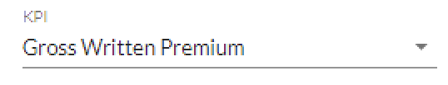
Available Filters
Portfolio segmentations available for analysis include the following:
OE
LoB
Industry Segment
Industry Cluster
Loss Type
All
All
All
All
All
All
AZUK
AZIT
…
All
Property
Liability
Construction
Engineering
All
Industry/Manufacturing
Non-industry
All
30 clusters segments (see Appendix for more details)
All
Attritional <1 million
Mid >1 million and <5 million
Large >5 million
Close Date
Customer Name
Ultimate Parent
2022-08-01
All
All
2022-08-01
2022-09-01
2022-10-01
…
All
UNIONE
(UK) IDES LIMITED TRADING AS IDES
…
All
UNIONE
(UK) IDES LIMITED TRADING AS IDES
…
Year Basis
Year
ISIC+
Calculation Basis
NatCat
UW Year
2022
All
Gross
All
UW Year
Accident Year
2018
2019
2020
2021
2022
All
658891
340900
340900
…
Gross
All
Yes
No

Slide 30
Mockups
Premium

Slide 31
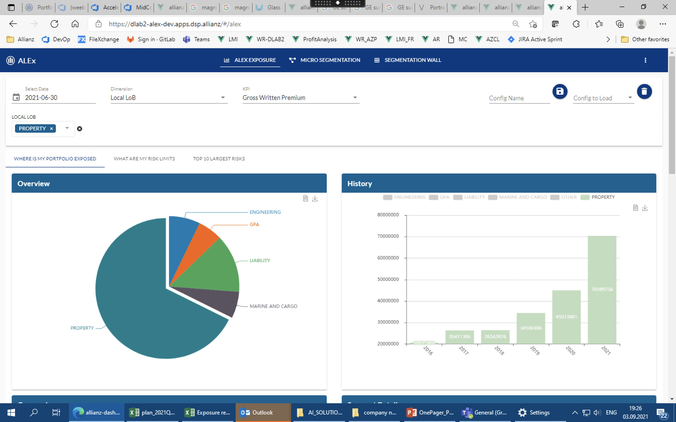
Global Commercial Portfolio Tool | Premium Development
Premium Development Claim Development Portfolio Performance Exposure & Accumulation Customer Profile Data Summary
OE
Close Date
LoB
Industry Segment
Industry Cluster
Loss Type
Year Basis
Year [Multiselectable]
Calculation Basis
NatCat
All
2022-08-01
All
All
All
All
UW Year
202l
Gross
All
Gross Written Premium
Gross Earned Premium
€300.7mn
€300.7mn
Gross Premium
Gross Premium
All years view
Split is customizable to be shown by LoB, Industry, Sub LoB
KPI can be selected as GWP or Gross Written Net Premium
Sub LOB
400,000,000
…
…
300,000,000
200,000,000
100,000,000
Agriculture, forestry & fishing
Textile & Tobacco MF-8
…
2018
2019
2020
2021
2022
UW year / Accident year
Agriculture, forestry & fishing
Textile & Tobacco MF-8
…

Slide 32
Global Commercial Portfolio Tool | Premium Development
Premium Development Claim Development Portfolio Performance Exposure & Accumulation Customer Profile Data Summary
OE
Close Date
LoB
Industry Segment
Industry Cluster
Loss Type
Year Basis
Year [Multiselectable]
Calculation Basis
NatCat
All
2022-08-01
All
All
All
All
UW Year
202l
Gross
All
KPIs presented on yearly basis – Underwriting & Accident Year
OE | LoB | Segment | Cluster | PolicyID | GWP ‘000 EUR | Loss ratio | GWP net increase ‘000 EUR
AZUK | Property | Industry/Manufacturing | Food: Meat & grocery MF-2 | 123456 | 100 | 50% | 1
AZUK | Property | Industry/Manufacturing | Textile & Tobacco MF-8 | 456789 | 80 | 7% | -1
AZUK | Liability | Non-industry | Agriculture, forestry & fishing | 789012 | 45 | 234% | 2
 | …

Slide 33
Claims
Mockups

Slide 34
Global Commercial Portfolio Tool | Claim Development
Premium Development Claim Development Portfolio Performance Exposure & Accumulation Customer Profile Data Summary
OE
Close Date
LoB
Industry Segment
Industry Cluster
Loss Type
Year Basis
Year [Multiselectable]
Calculation Basis
NatCat
All
2022-08-01
All
All
All
All
UW Year
202l
Gross
All
Severity
Frequency
€11.5k
Prior 5 year average: €11.8k
724.8
Prior 5 year average: 1.2k
Loss Ratio
Loss Ratio
…
Insight of loss ratio split by claim type, by choice of category or by is available in another ALEX report
Insight of loss ratio split by UWY / AY for time series development
400,000,000
…
400,000,000
…
…
…
300,000,000
300,000,000
200,000,000
200,000,000
100,000,000
100,000,000
Agriculture, forestry & fishing
Textile & Tobacco MF-8
….
….
….
2018
2019
2020
2021
2022
UW year / Accident year
Attritional
Medium
Large Cat
Attritional
Medium
Large Cat

Slide 35
Global Commercial Portfolio Tool | Claim Development
Premium Development Claim Development Portfolio Performance Exposure & Accumulation Customer Profile Data Summary
OE
Close Date
LoB
Industry Segment
Industry Cluster
Loss Type
Year Basis
Year [Multiselectable]
Calculation Basis
NatCat
All
2022-08-01
All
All
All
All
UW Year
202l
Gross
All
OE | LoB | Segment | Cluster | PolicyID | Frequency | Severity | Loss Ratio
AZUK | Property | Industry/Manufacturing | Food: Meat & grocery MF-2 | 123456 | 12 | 100 | 100%
AZUK | Property | Industry/Manufacturing | Textile & Tobacco MF-8 | 456789 | 6 | 80 | 20%
AZUK | Liability | Non-Industry | Agriculture, forestry & fishing | 789012 | 4 | 45 | 80%
 | …

Slide 36
Portfolio Performance
Mockups

Slide 37
Global Commercial Portfolio Tool | Portfolio Performance
Premium Development Claim Development Portfolio Performance Exposure & Accumulation Customer Profile Data Summary
New Filters
OE
Close Date
LoB
Industry Segment
Industry Cluster
Loss Type
Year Basis
Year [Multiselectable]
Calculation Basis
NatCat
All
2022-08-01
All
All
All
All
UW Year
202l
Gross
All
Loss Ratio by Industry Cluster
GWP Net growth by Industry Cluster
Industry Cluster
average Loss Ratio benchmark
Industry Cluster
Agriculture, forestry & fishing
20%
Agriculture, forestry & fishing
+100
Textile & Tobacco MF-8
50%
Textile & Tobacco MF-8
+120
…
…
80% Loss Ratio Benchmark
Loss Ratio in %
GWP net growth
in € mn.

Slide 38
Global Commercial Portfolio Tool | Portfolio Performance
Premium Development Claim Development Portfolio Performance Exposure & Accumulation Customer Profile Data Summary
New Filters
OE
Close Date
LoB
Industry Segment
Industry Cluster
Loss Type
Year Basis
Year [Multiselectable]
Calculation Basis
NatCat
All
2022-08-01
All
All
All
All
UW Year
202l
Gross
All
Loss Ratio
Loss Ratio by year
GWP net growth by year
Loss Ratio on yearly basis as well as on cumulative basis
Not cumulative
Net Growth on yearly basis as well as on cumulative basis
Not cumulative
400,000,000
…
400,000,000
…
…
…
300,000,000
300,000,000
200,000,000
200,000,000
100,000,000
100,000,000
2018
2019
2020
2021
2022
UW year / Accident year
2018
2019
2020
2021
2022
UW year / Accident year
Agriculture, forestry & fishing
Textile & Tobacco MF-8
…
Agriculture, forestry & fishing
Textile & Tobacco MF-8
…
OE | LoB | Segment | Cluster | PolicyID | GWP ‘000 EUR | Loss ratio | GWP net increase ‘000 EUR
AZUK | Property | Industry/Manufacturing | Food: Meat & grocery MF-2 | 123456 | 100 | 50% | 1
AZUK | Property | Industry/Manufacturing | Textile & Tobacco MF-8 | 456789 | 80 | 7% | -1
AZUK | Liability | Non-Industry | Agriculture, forestry & fishing | 789012 | 45 | 234% | 2
 | …

Slide 39
Exposure & Accumulation
Mockups

Slide 40
Report Segment
OE Name: All
LoB: All
SubLob: All
AZ_ISIC_PLUS: All
<Additional Filter>
KPIs
Number of Policies
Global Commercial Portfolio Tool | Exposure & Accumulation
Premium Development Claim Development Portfolio Performance Exposure & Accumulation Customer Profile Data Summary
OE
Close Date
LoB
Industry Segment
Industry Cluster
Loss Type
Year Basis
Year [Multiselectable]
Calculation Basis
NatCat
All
2022-08-01
All
All
All
All
UW Year
202l
Gross
All
PROPERTY Sum Insured Distribution
LIABILITY Gross Limit Distribution
Industry Cluster
Industry Cluster
min
avg
max
min
avg
max
Agriculture, forestry & fishing
Food: Meat & grocery MF-2
Textile & Tobacco MF-8
Textile & Tobacco MF-8
…
…
Avg TSI
Property only
Avg Gross Limit
LIliability only

Slide 41
Report Segment
OE Name: All
LoB: All
SubLob: All
AZ_ISIC_PLUS: All
<Additional Filter>
KPIs
Number of Policies
Global Commercial Portfolio Tool | Exposure & Accumulation
Premium Development Claim Development Portfolio Performance Exposure & Accumulation Customer Profile Data Summary
OE
Close Date
LoB
Industry Segment
Industry Cluster
Loss Type
Year Basis
Year [Multiselectable]
Calculation Basis
NatCat
All
2022-08-01
All
All
All
All
UW Year
202l
Gross
All
PROPERTY Sum Insured Distribution
LIABILITY Gross Limit Distribution
400,000,000
…
400,000,000
…
…
…
300,000,000
300,000,000
200,000,000
200,000,000
100,000,000
100,000,000
2018
2019
2020
2021
2022
UW year / Accident year
2018
2019
2020
2021
2022
UW year / Accident year
Agriculture, forestry & fishing
Textile & Tobacco MF-8
…
Agriculture, forestry & fishing
Textile & Tobacco MF-8
…
OE | LoB | Segment | Cluster | PolicyID | TSI 2018 (property only) mn EUR | Gross Limit 2018 (liability only) mn EUR
AZUK | Property | Industry/Manufacturing | Food: Meat & grocery MF-2 | 123456 | 100 | -
AZUK | Property | Industry/Manufacturing | Textile & Tobacco MF-8 | 456789 | 80 | -
AZUK | Liability | Non-industry | Agriculture, forestry & fishing | 789012 | - | 70
 | …

Slide 42
Customer Profile
Mockups

Slide 43
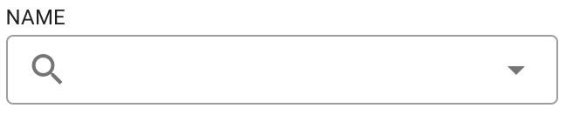
Report Segment
OE Name: All
LoB: All
SubLob: All
AZ_ISIC_PLUS: All
<Additional Filter>
KPIs
Number of Policies
Global Commercial Portfolio Tool | Customer Profile
Premium Development Claim Development Portfolio Performance Exposure & Accumulation Customer Profile Data Summary
OE
Close Date
LoB
Industry Segment
Industry Cluster
Loss Type
Year Basis
Year [Multiselectable]
Calculation Basis
NatCat
All
2022-08-01
All
All
All
All
UW Year
202l
Gross
All
Customer Name
Ultimate Parent
List of customers and related entities
Customer Name | Ultimate Parent | LoB | TSI 2018 (property only) mn EUR | Gross Limit 2018 (liability only) mn EUR | 2018 GWP ‘000 EUR | 2018 Loss Ratio | Industry Cluster
ABC Hampshite Ltd | ABC Group Ltd | Property | 10 | - | 10 | 50% | Food: Meat & grocery MF-2
ABC UK Logistics Ltd | ABC Group Ltd | Property | 10 | - | 9 | 7% | Transportation & storage
Small A Company | Small SE | Liability | - | 20 | 6 | 234% | Agriculture, forestry & fishing
…

Slide 44
Data Summary
Mockups

Slide 45
Report Segment
OE Name: All
LoB: All
SubLob: All
AZ_ISIC_PLUS: All
<Additional Filter>
KPIs
Number of Policies
Global Commercial Portfolio Tool | Data Summary
Premium Development Claim Development Portfolio Performance Exposure & Accumulation Customer Profile Data Summary
OE
Close Date
LoB
Industry Segment
Industry Cluster
Loss Type
Year Basis
Year [Multiselectable]
Calculation Basis
NatCat
All
2022-08-01
All
All
All
All
UW Year
202l
Gross
All
Data Summary
OE | Count Business Keys | Count distinct business keys | Sum 5yr cum GWP | Sum 5yr cum Claim Cost | Sum 5yr cum Claim Cost < 1mn | Sum 5yr cum Claim Cost > 1mn & < 5mn | Sum 5yr cum Claim Cost > 5mn | Sum TSI | Sum Gross Limit | Avg 5yr Loss Ratio
Allianz Italy (IT) | 64630 | 64630 | 737,887,354
Allianz UK | 113247 | 65290 | 3,337,887,354
…
Exposure & Accumulation Statistics
OE | Count Business Keys | Count distinct business keys | Sum TSI | Sum Gross Limit
Allianz Italy (IT) | 73896 | 73896 | 158,337,887,354 | 101,302,800,063
Allianz UK | 135583 | 70488 | 258,337,887,354 | 201,302,800,063
…

